Slide 1
Investigation of Homoclinic Orbits in the Circular Restricted Three Body Problem
Luke Bury & Don Kuettel
05/02/18

Slide 2
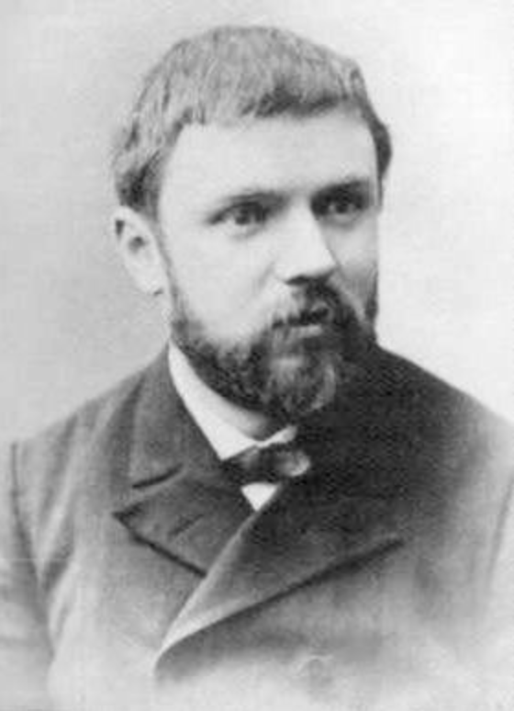
Poincaré
1854-1912
French mathematician/ polymath
Contributions to:
Celestial mechanics
Fluid mechanics
Optics
Electricity
Telegraphy
Elasticity
Thermodynamics
Quantum Theory
Theory of Relativity
More…^{[*1]}
[*1] - https://en.wikipedia.org/wiki/Henri_Poincare

Slide 3
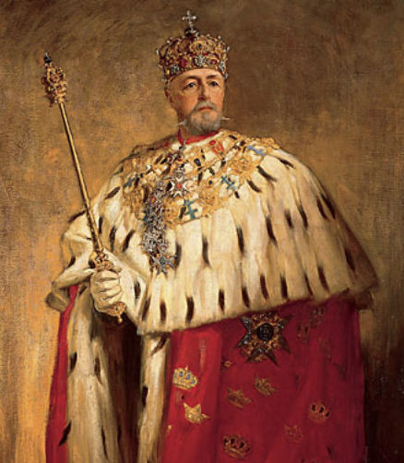
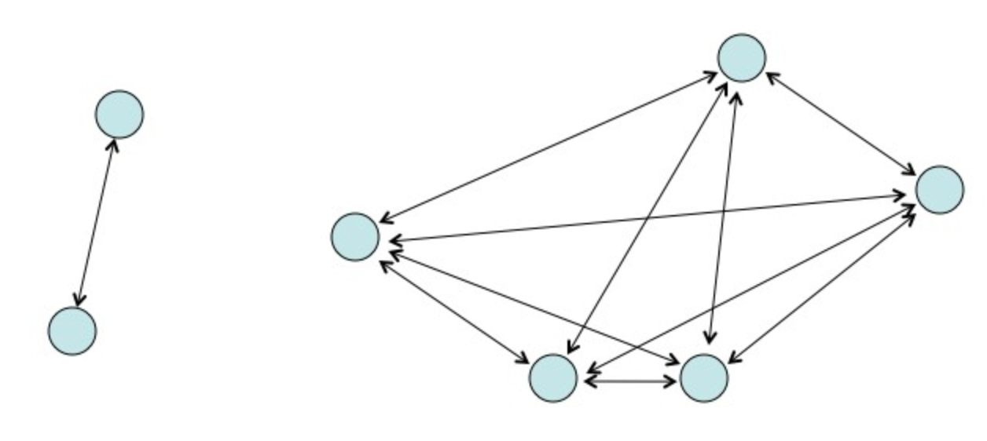
The Competition
Acta Mathematica, 1885
King Oscar II of Sweden
4 unanswered problems
Solve the N-Body Problem
Poincaré went for the Circular Restricted Three Body Problem (CR3BP)
Submitted and won
Critical error discovered around the time of the earliest printings
Led to discovery of Homoclinic Orbits
[*2]https://commons.wikimedia.org/wiki/File:Oscar_II_of_Sweden_painted_by_Oscar_Bj%C3%B6rck_(original).jpg
[*3] - http://www.askamathematician.com/2011/10/q-what-is-the-three-body-problem/
Notes:
-Sponsored by the King
-[*2] - https://commons.wikimedia.org/wiki/File:Oscar_II_of_Sweden_painted_by_Oscar_Bj%C3%B6rck_(original).jpg
-[*3] - http://www.askamathematician.com/2011/10/q-what-is-the-three-body-problem/

Slide 4
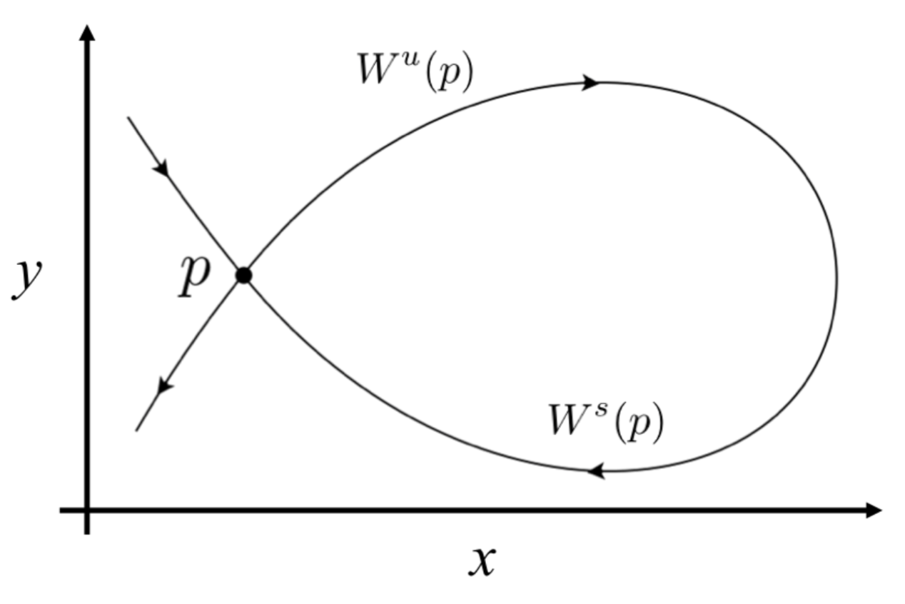
Homoclinic Orbits
A trajectory which joins a saddle equilibrium point to itself
A union between a stable and unstable manifold
Orbit approaches P at both (+)∞ and (–)∞

Slide 5
Locating Homoclinic Orbits
Periodic orbit (PO)
Stable and unstable manifolds
Manifold intersections via Poincaré sections
Homoclinic points are identified

Slide 6
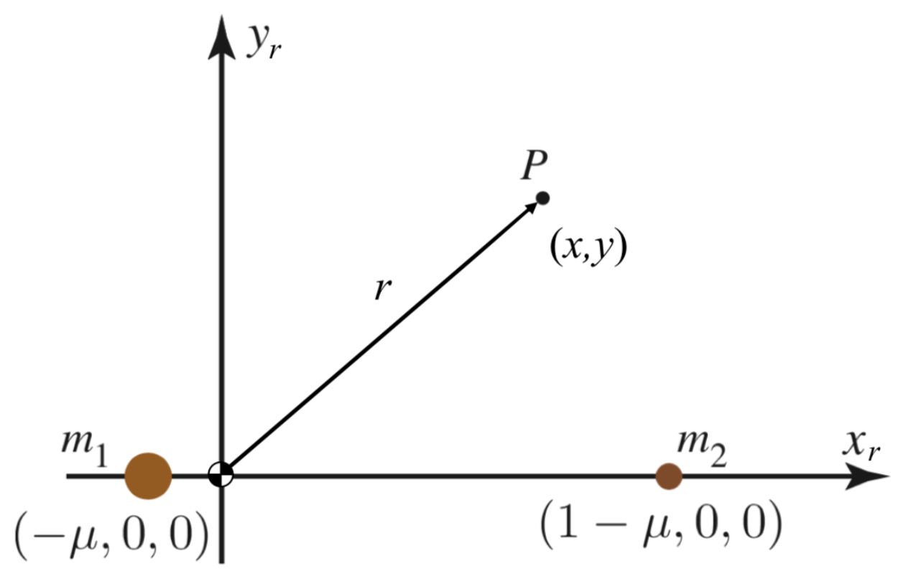
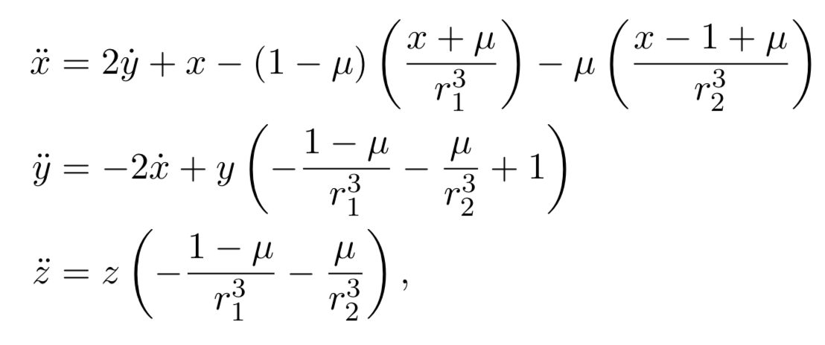
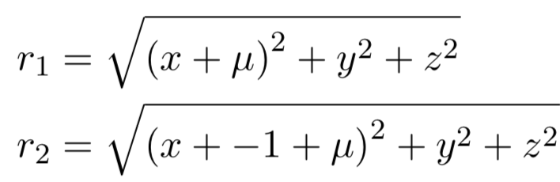
Circular Restricted Three Body Problem
Discuss setup, normalizations

Slide 7
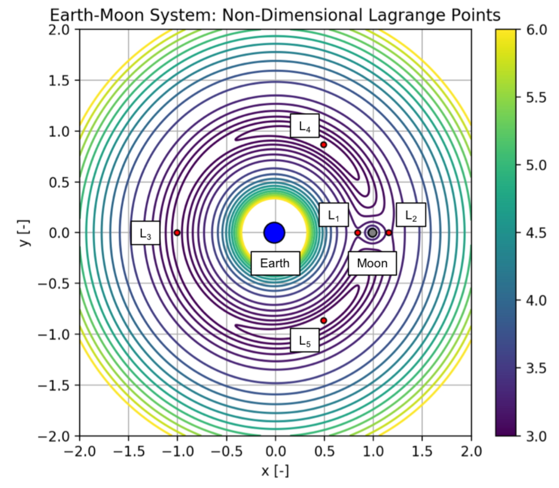
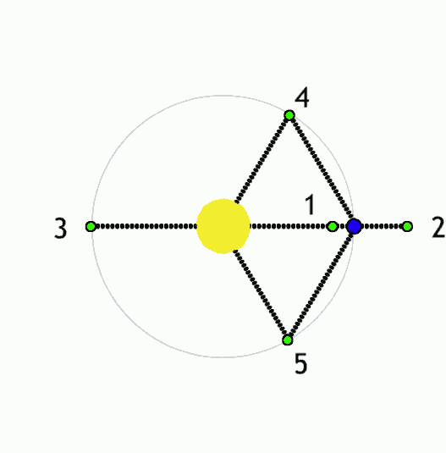
Equilibrium Points & Stability
Discuss saddle & Lyapunov stability
Notes:
Mention Trojan asteroids in Sun-Jupiter L4,5 points
Difficult to solve for. Need to use numerical methods for L1,2,3
L4,5 only stable if M1/M2 > 24.96
ZV curves
Jacobi constant

Slide 8
Periodic Orbits & Families
Definition & description … high level of how to find them

Slide 9
Periodic Orbits & Families

Slide 10
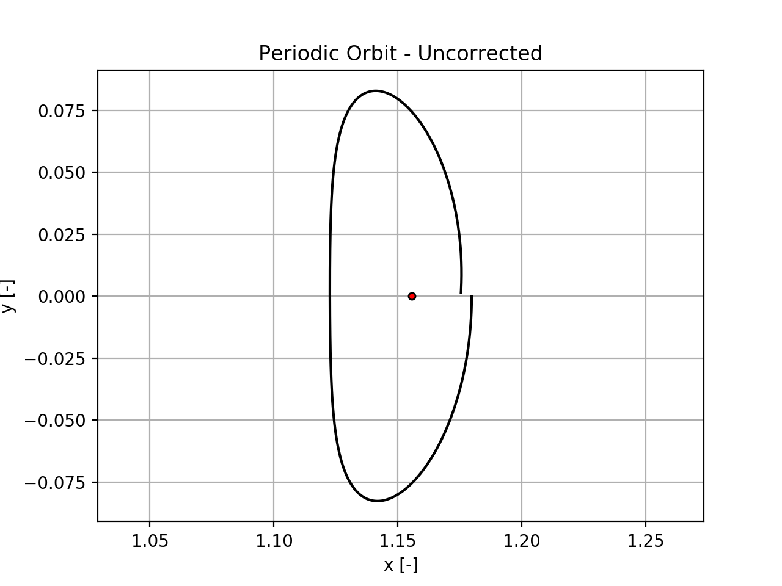
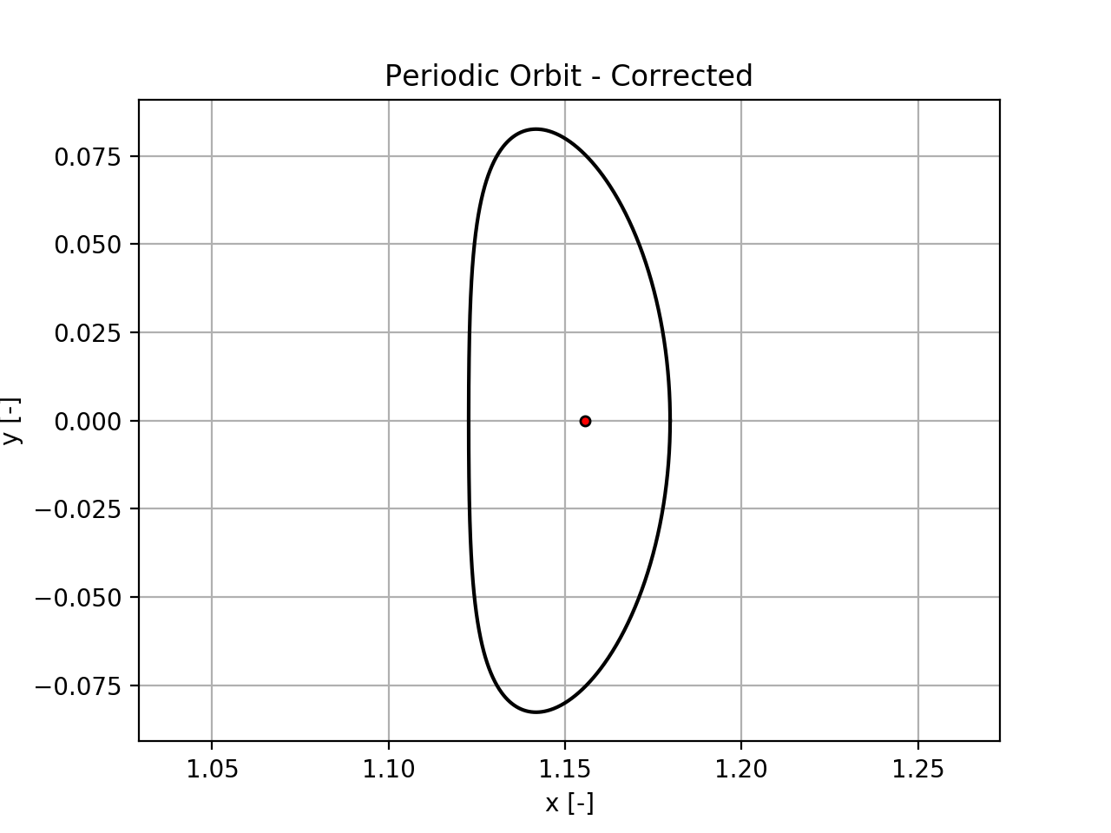
Periodic Orbits & Families

Slide 11
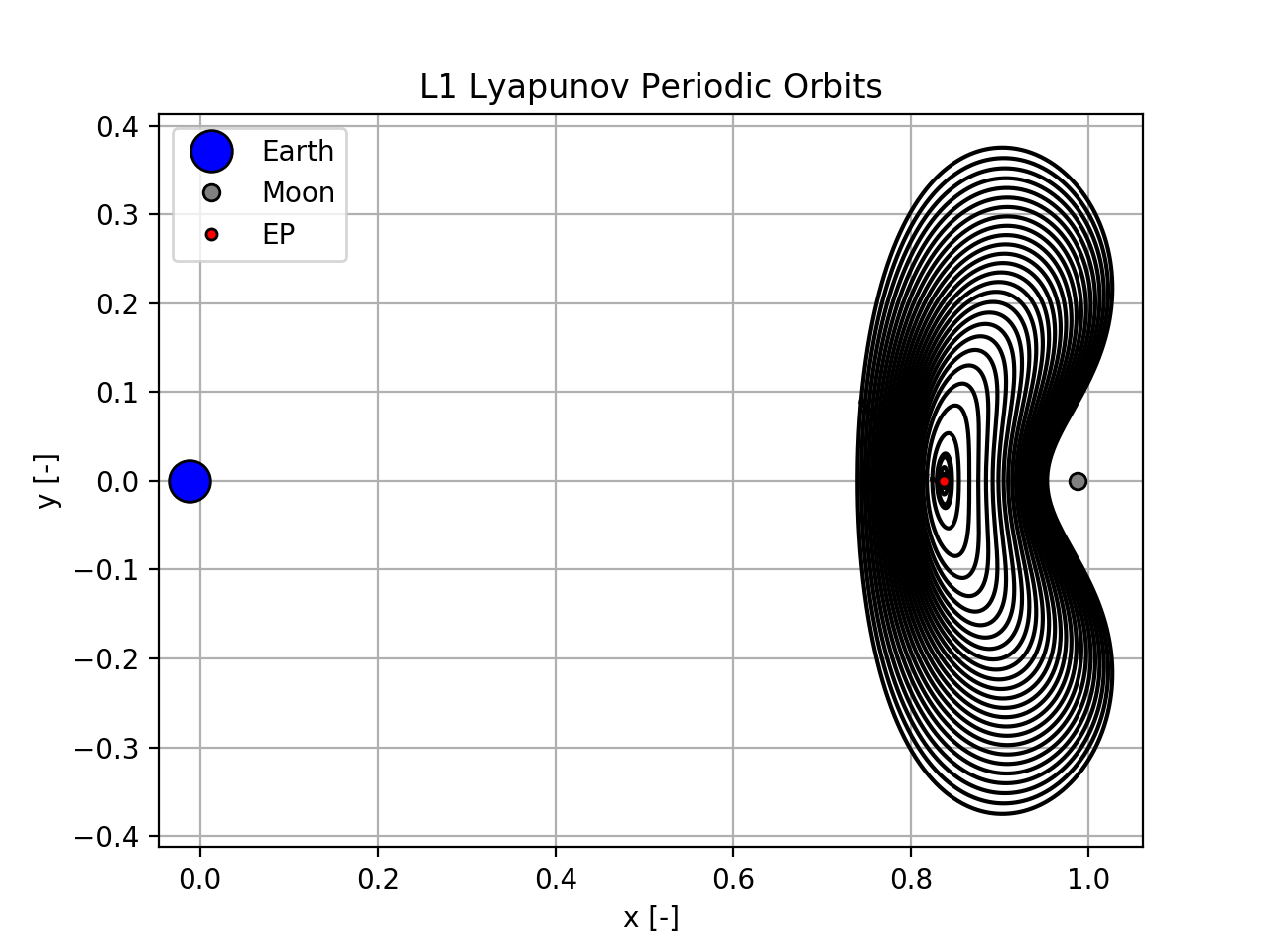
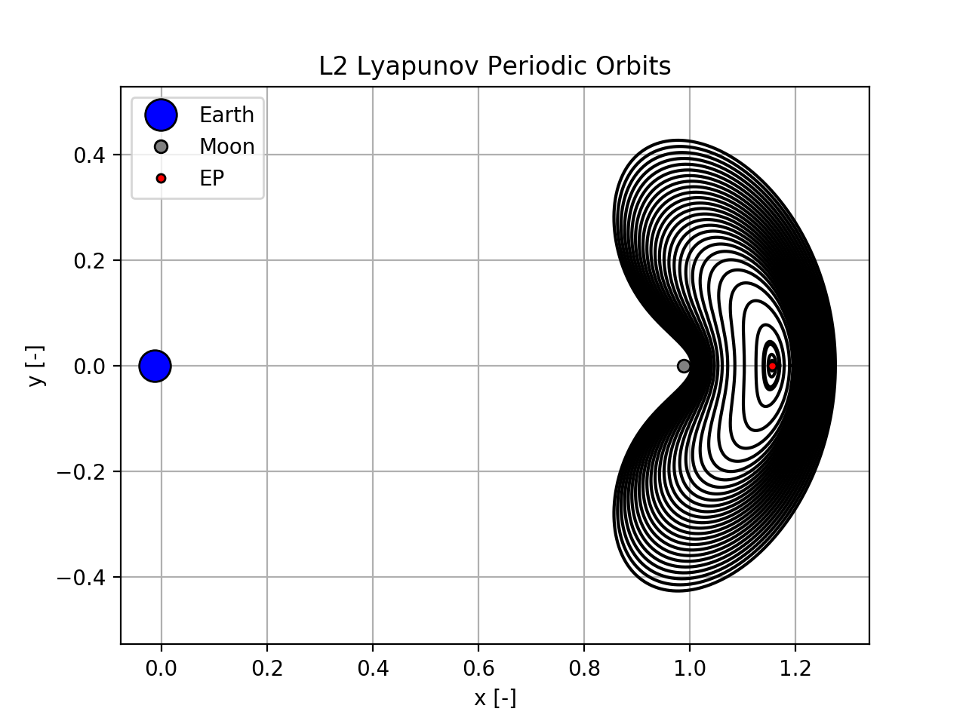
Periodic Orbits & Families

Slide 12
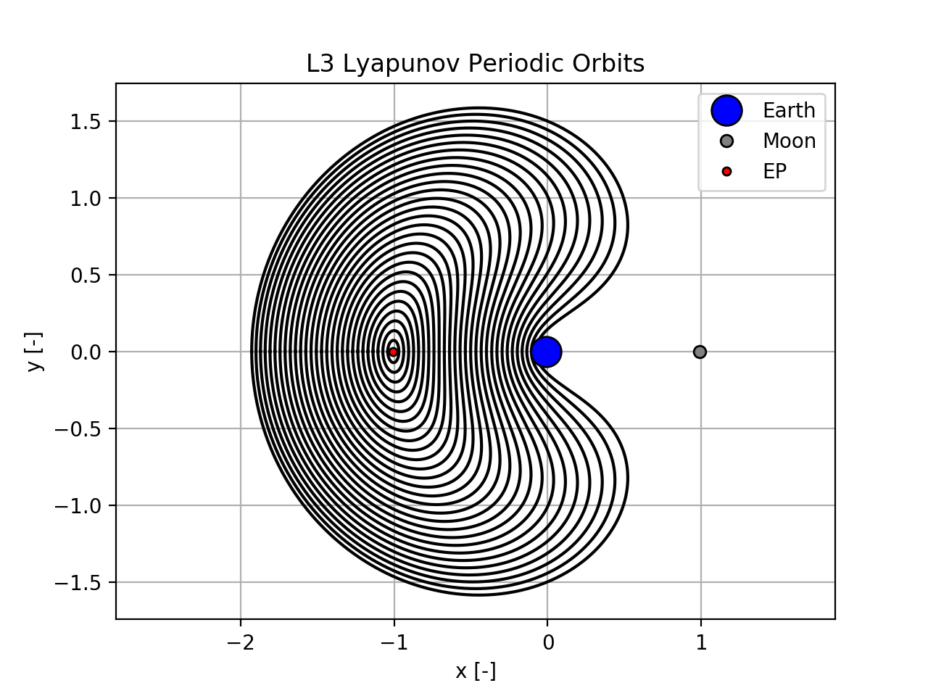
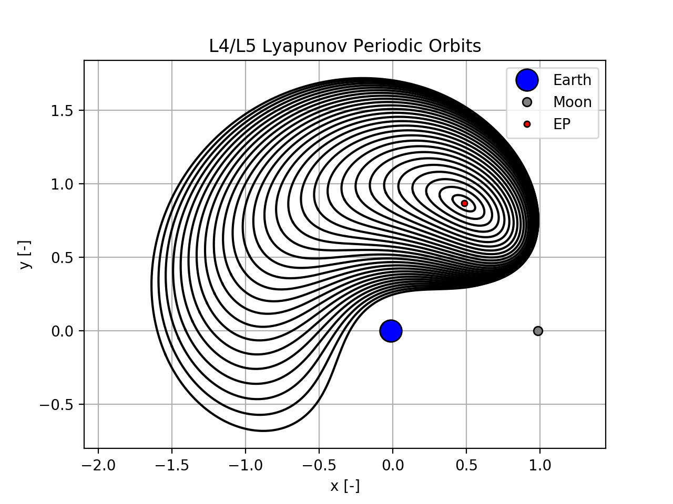
Periodic Orbits & Families

Slide 13
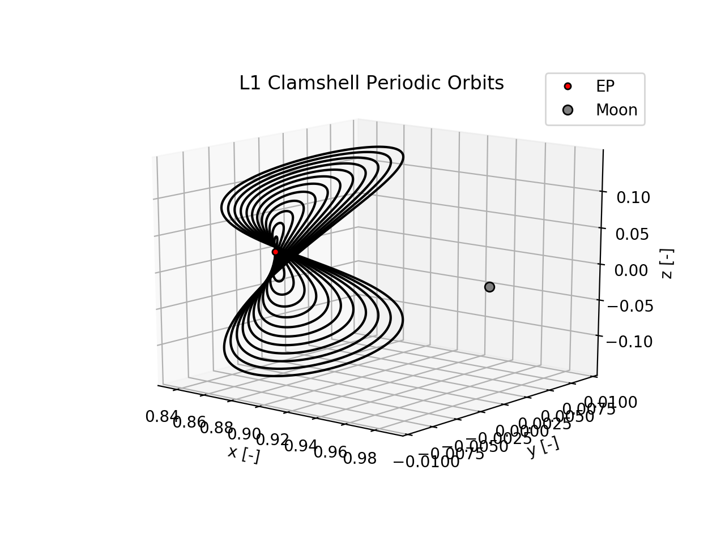
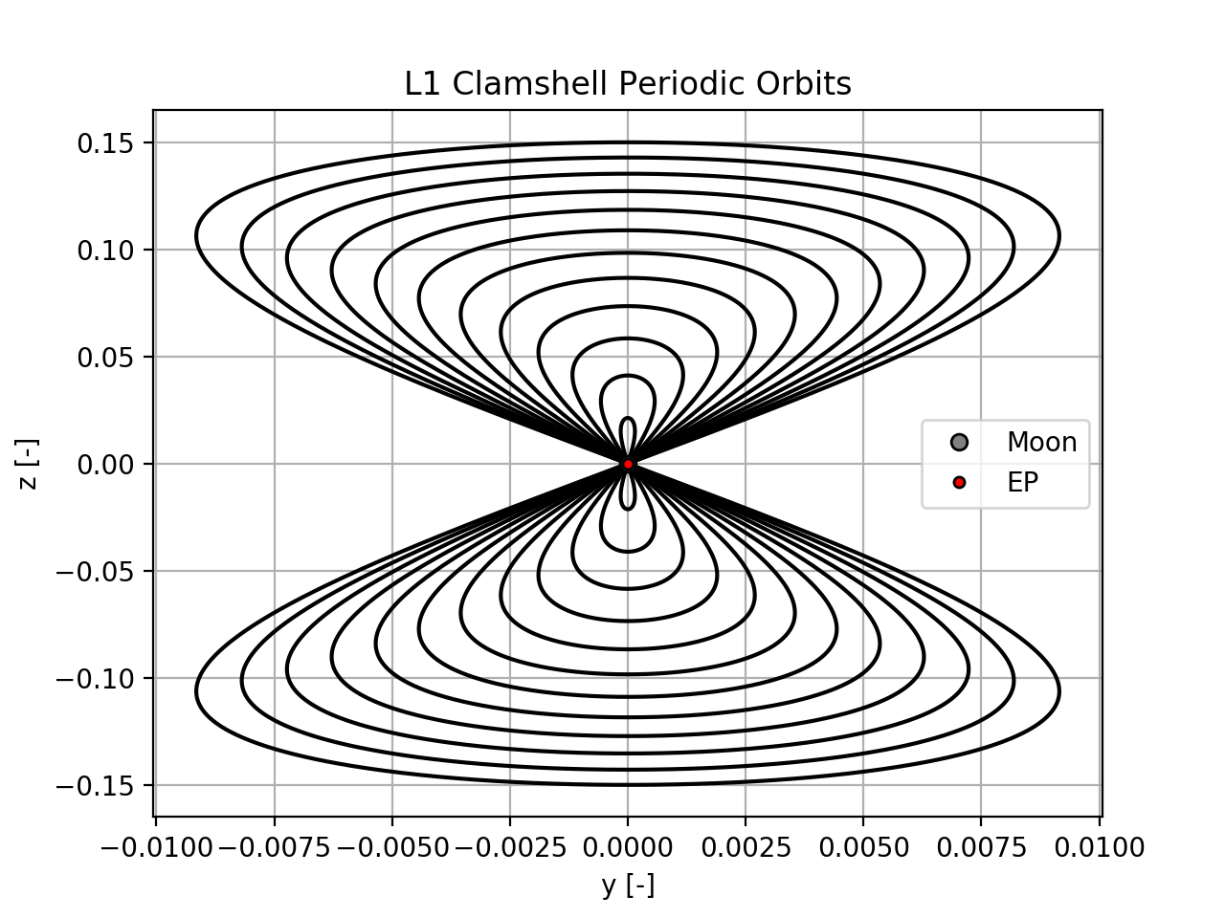
Periodic Orbits & Families

Slide 14
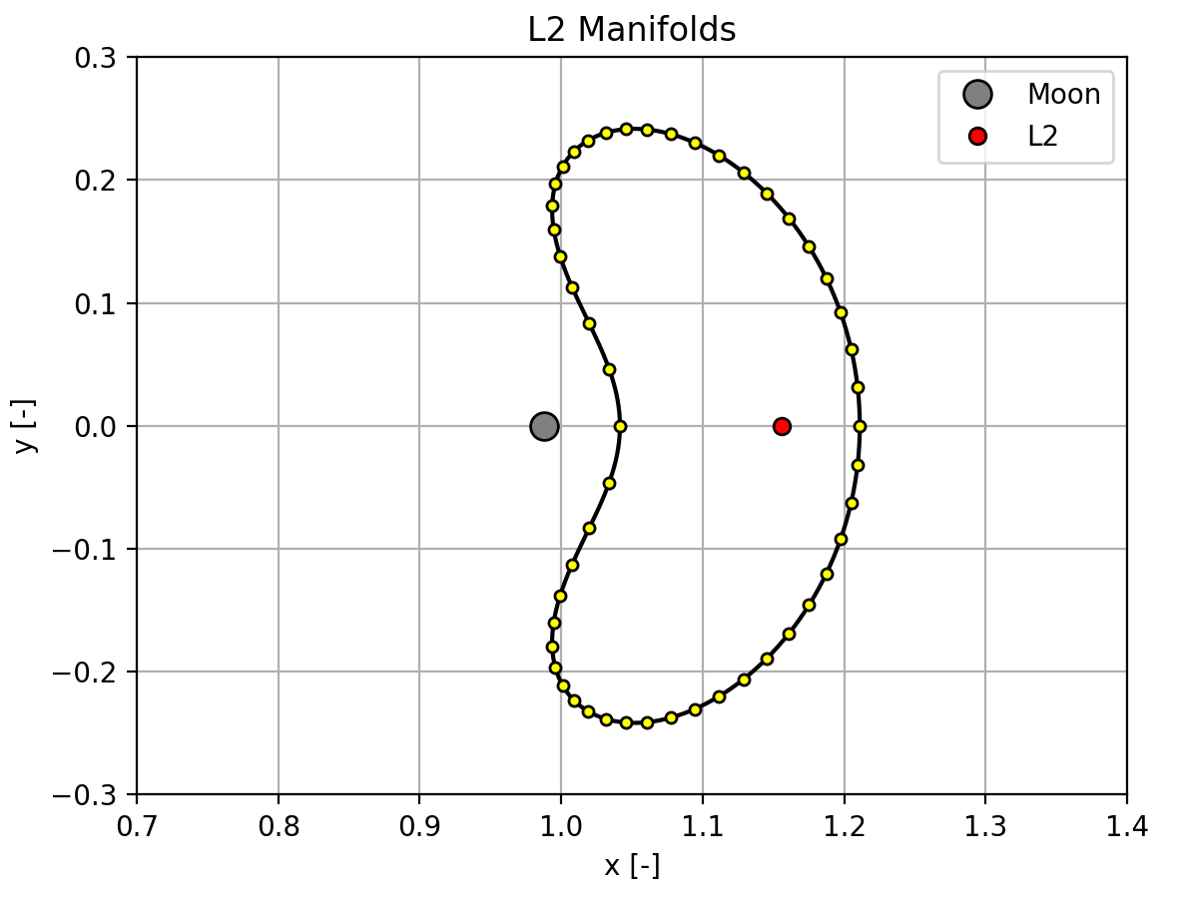
Periodic Orbit Stability and Manifolds
Discussion of how discretizing and nudging the PO in the stable/unstable direction then propagating backwards/forwards in time reveals manifolds

Slide 15
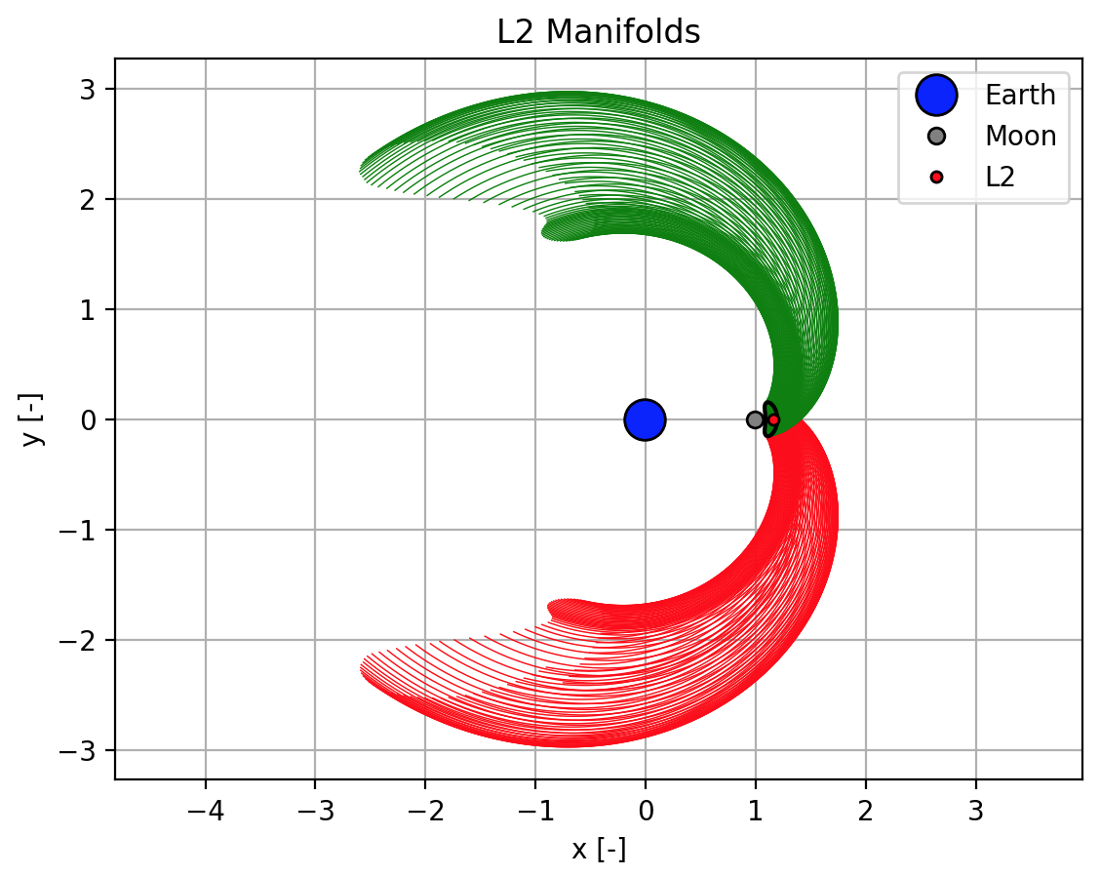
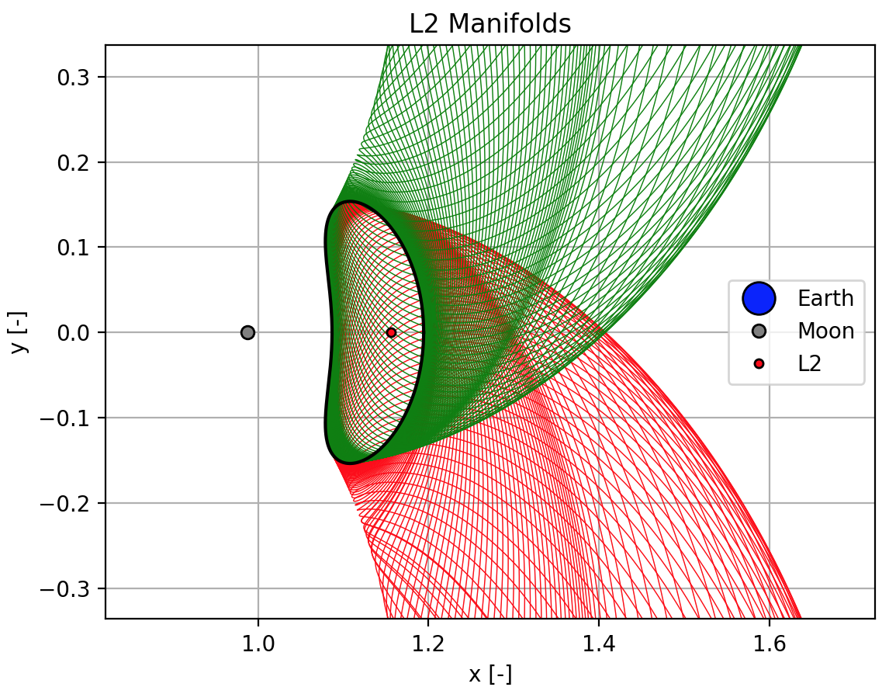
Periodic Orbit Stability and Manifolds

Slide 16
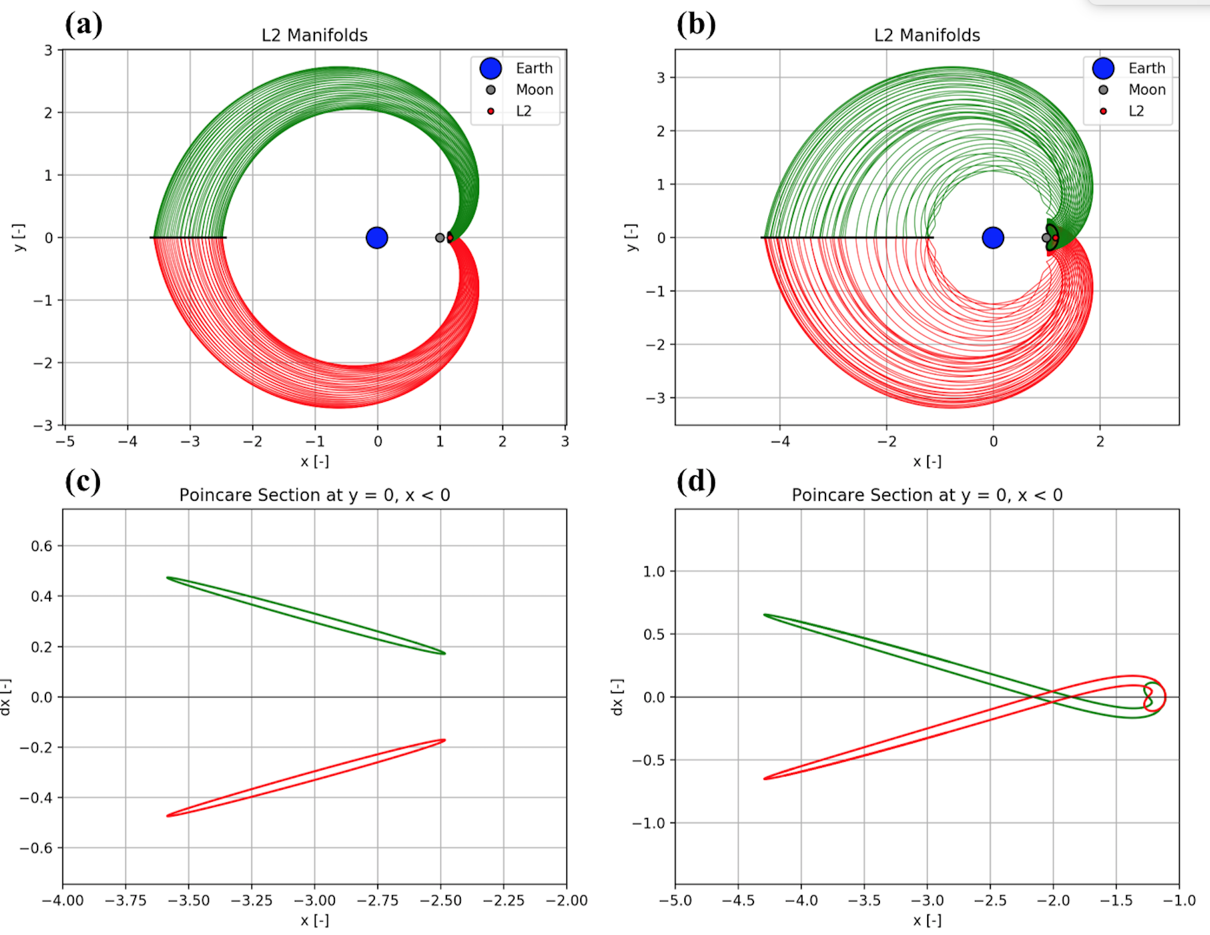
Poincaré Sections & Homoclinic Orbits

Slide 17
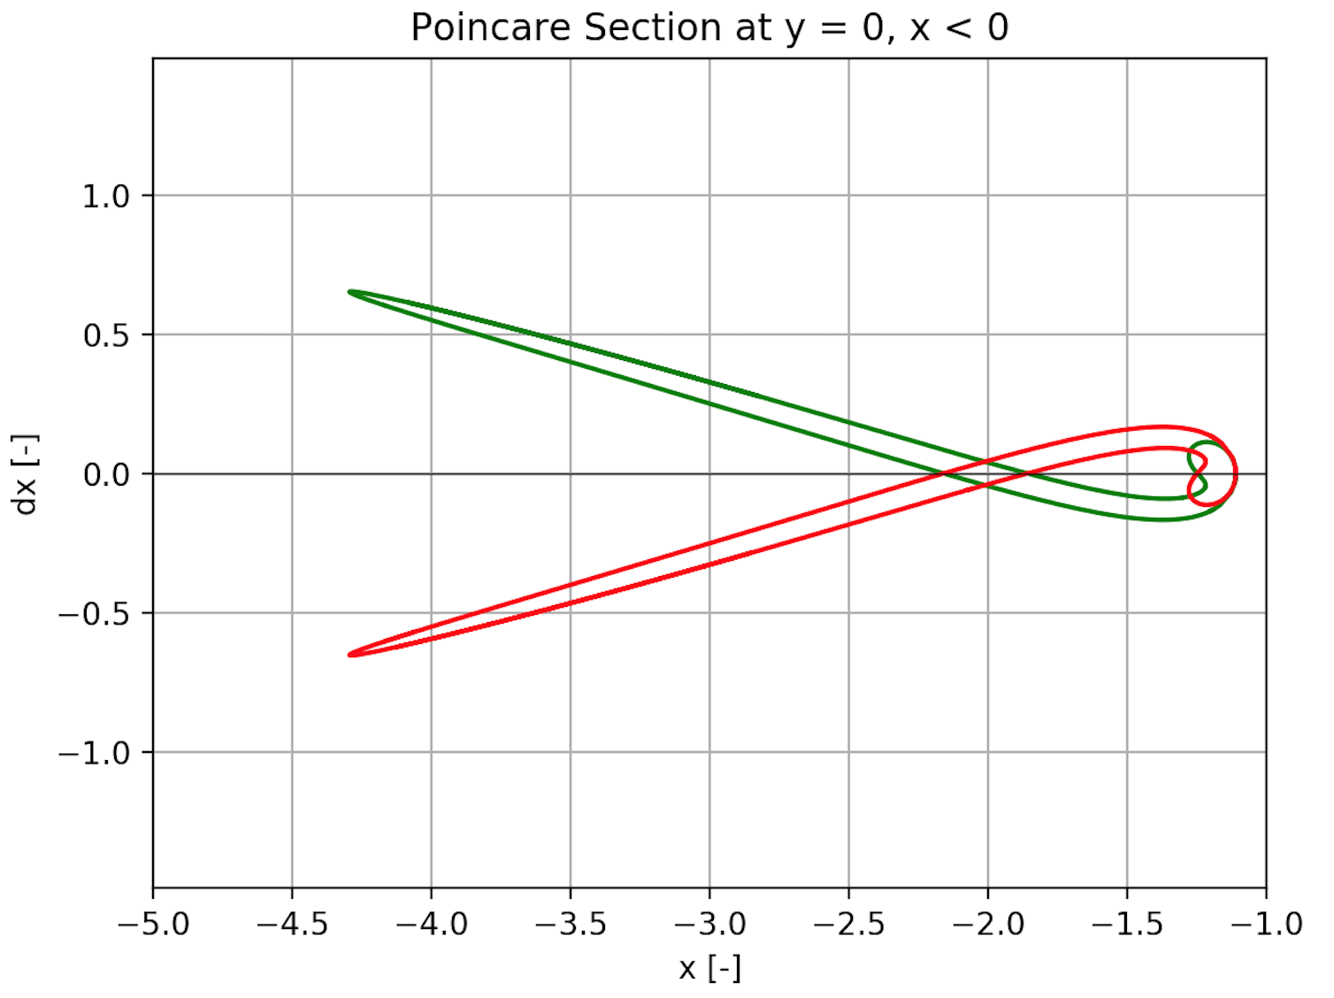
Poincaré Sections & Homoclinic Orbits
= Homoclinic Orbit

Slide 18
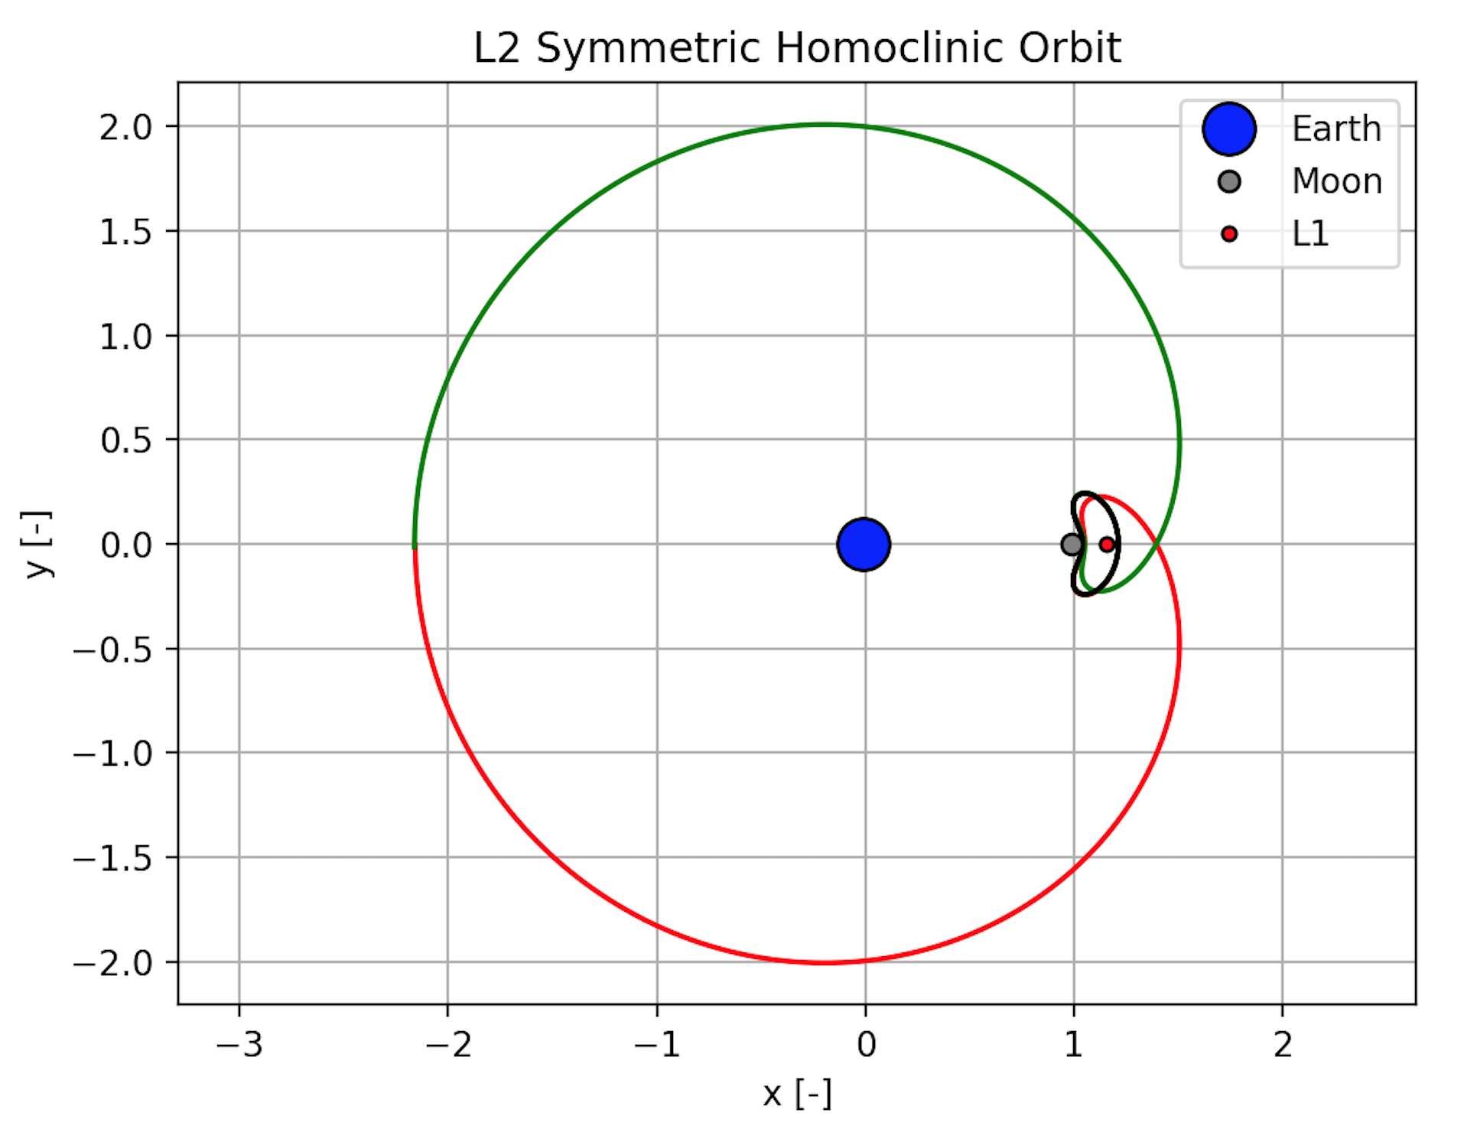
Poincaré Sections & Homoclinic Orbits

Slide 19
Significance and Usefulness of Homoclinic Orbits
Understand the flow of dynamic systems
For mission design, heteroclinic are generally more valuable
Notes:
-Homoclinic orbits can help understand flow of dynamic system, but for mission design, heterclinic orbits are of much greater use (moon transfers, etc)
-Can cite some papers

Slide 20
References
https://en.wikipedia.org/wiki/Henri_Poincare

